Slide 1
3 Ways of Heat Transfer
Convection
Conduction
Radiation

Slide 2
Conduction
Conduction--transfer of heat between atoms as they collide within a substance
2 objects touching

Slide 3
Convection
Convection is the movement of matter due to differences in density that are caused by temperature
Important in weather, plate tectonics, and ocean currents

Slide 4
Radiation
Radiation is the transfer of energy by electromagnetic waves, such as visible light and infrared waves
Key form = sunlight

Slide 5
Phases of Matter
  There are 3 main phases of matter:
    Solid, Liquid, and Gas (a 4th is sometimes included—plasma)
    Each phase requires a certain amount of kinetic energy

Slide 6
Solids
Require the least amount of energy
Very low particle movement
Usually associated with low temperatures
When solids gain enough energy they change through a process called MELTING

Slide 7
Liquids
More energy than solids, less than gases
Take the shape of their container because they have more freedom to move than solids
Liquids can lose energy to become solid through a process called FREEZING
Liquids can also gain energy to become gases through a process called EVAPORATION

Slide 8
Gases
Have the most energy of the 3 phases
Particles move around very freely
Usually associated with high temperatures
If gases lose energy (temperature), they can change back to a liquid through a process called CONDENSATION

Slide 9
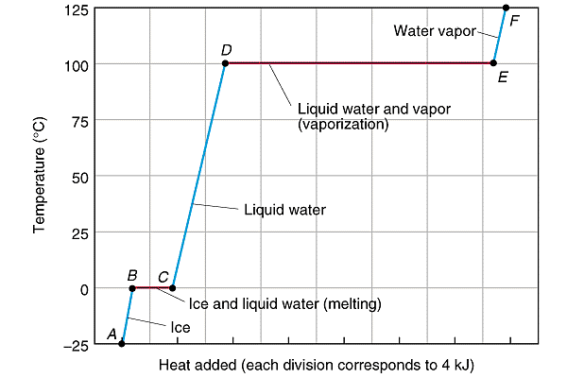

Slide 10
